Slide 1
Speaker Adaptation Techniques (2)
語者調適技術之簡介
Works Done by Lucent Bell Lab
Eigenvoice
Presenter: 陳冠廷 (Kuan-Ting Chen)
Advisor: 李琳山教授 (Prof. Lin-Shan Lee)
Digital Speech Processing Laboratory
Graduate Institute of Communication Engineering
National Taiwan University

Slide 2
Outline
Basic Concepts
Review
  MAP (Maximum A Posteriori estimation)
  MLLR (Maximum Likelihood Linear Regression)
Works Done by Lucent Bell Lab (SMAP, MAPLR, SMAPLR)
Eigenvoice Approach
Conclusion
References and Advanced Study

Slide 3
Basic Concepts

Slide 4



Speaker Characteristics:
Practical Issue in Speech Recognition
General HMM-based Acoustic Recognition System
Front-end
Pre-processing
Feature
Extraction
HMM
Training
waveform
Sequence of feature vectors
transcription: “三六”
Speaker Char.
Mismatch
Model for “三”
Speaker Indep.
(SI) HMM set
Speaker Indep.
(SI) HMM set
Model for “六”
Training
Recognition
Front-end
Pre-processing
Feature
Extraction
Pattern
Matching
Recognition output:
“三九”

Slide 5
Strategy 1: Feature-based Normalization
將語者間的特性差異以正規化技術消除
Front-end
Pre-processing
Feature
Extraction
HMM
Training
Feature-based
Normalization
Mismatch
Model for “三”
Speaker Indep.
(SI) HMM set
Model for “六”
Training
Recognition
Front-end
Pre-processing
Feature
Extraction
Pattern
Matching
Recognition output:
“三六”
Feature-based
Normalization

Slide 6
Strategy 2: HMM Adaptation
調整模型參數，使其更準確地模擬新語者特性
Front-end
Pre-processing
Feature
Extraction
HMM
Training
Mismatch
Model for “三”
Speaker Indep.
(SI) HMM set
Model for “六”
Training
Recognition
Front-end
Pre-processing
Feature
Extraction
Pattern
Matching
HMM
Adaptation
Pattern
Matching

Slide 7
Acoustic Model Adaptation: Scenario 1
Supervised Batch Adaptation
監督式批次調適法：存在一調適語料集可用以重估模型，且語料內容已知
Speaker Indep.
(SI) HMM set
Adaptation data (調適語料)
Front-end
Pre-processing
Feature
Extraction
Model Parameter
Re-estimation
Model Parameter
Re-estimation
Transcription (語料對應之標音內容)
Speaker Dependent
(SD) HMM set
Test data (測試語料)
Front-end
Pre-processing
Feature
Extraction
Pattern
Matching
Recognition results

Slide 8
Acoustic Model Adaptation: Scenario 2
Unsupervised Batch Adaptation
非監督式批次調適法：存在一調適語料集可用以重估模型，但語料內容未知
Speaker Indep.
(SI) HMM set
Adaptation data (調適語料)
Iterative re-estimation (疊代式重估)
Front-end
Pre-processing
Feature
Extraction
Pattern
Matching
Model Parameter
Re-estimation
“Guessed Transcription”
Speaker Dependent
(SD) HMM set
Test data (測試語料)
Front-end
Pre-processing
Feature
Extraction
Pattern
Matching
Recognition results

Slide 9
Acoustic Model Adaptation: Scenario 3
Unsupervised Self-Adaptation
非監督式自我調適法：利用測試語料的初次辨識結果調整模型，重新辨識
Speaker Indep.
(SI) HMM set
Test data (測試語料)
Front-end
Pre-processing
Feature
Extraction
Pattern
Matching
Recognition results
Iterative re-estimation
Model Parameter
Re-estimation
實用上，多採 incremental adaptation (遞增式調適法)，或稱 on-line adaptation (線上調適法)：
(e.g.) 辨識(1-5)句，利用(1-5)句重估模型，再辨識(1-10)句，再利用(1-10)句重估模型，and so on.
Speaker Dependent
(SD) HMM set

Slide 10
Review (MAP, MLLR)

Slide 11
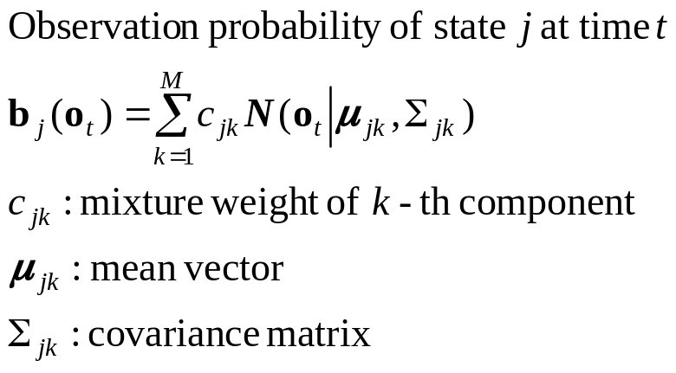
Here Comes Mathematics: Background
Continuous Density HMM (CDHMM)
  Parameter set λ = {A, B, π}
Observation sequence
O = {o₁, o₂ , …, o_{T}}
Set of HMM’s
Gaussian (Normal) distribution
Model
State j
(j = 1,…, N)
A:
Trans. Prob.
π:
Initial Prob.
Mixture 1
Mixture 2
Mixture M

Slide 12
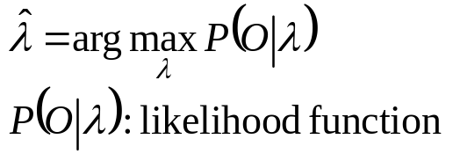
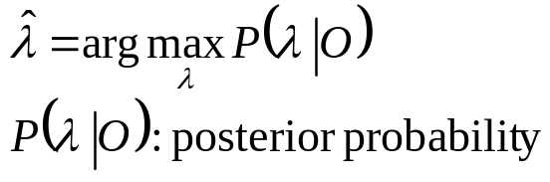
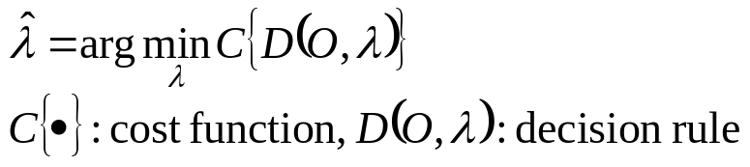
Model Parameter Re-estimation:
Problem Formulation
Step 1: Set Statistical Criterion
  Maximum Likelihood (ML) 最大相似度估測
  Maximum A Posteriori (MAP) 最大後機率估測
  Minimum Classification Error (MCE) 最小分類誤差估測
Standard HMM Training
MLLR Adaptation
Formulation
MAP Adaptation

Slide 13

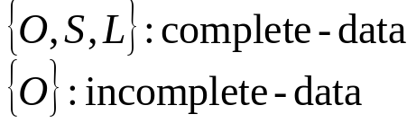
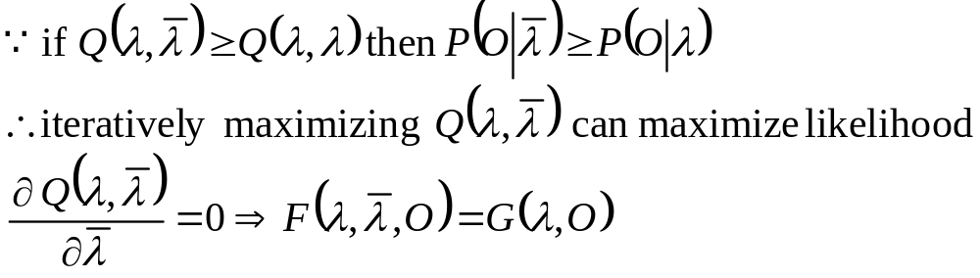
Model Parameter Re-estimation:
Problem Formulation (Example: ML)
Step 2: Find Object Function (E-step)
  Since the state sequence S and mixture sequence L are considered to be hidden, the ML estimate λ_{ML} cannot be derived as a closed form solution
  Auxiliary function
Step 3: Maximize Object Function to get Re-estimation Formulae (M-step)
EM Algorithm 期望值最大法
Complete-data log-likelihood
Set of Re-estimation formulae

Slide 14
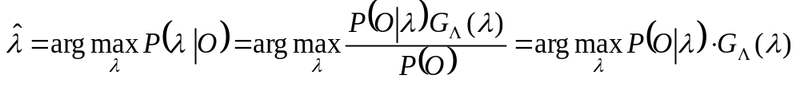

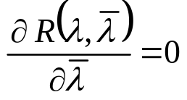
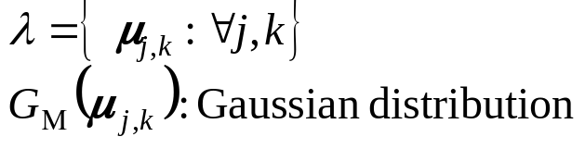
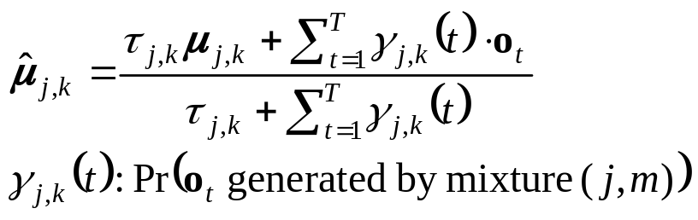
Maximum A Posteriori Estimation (MAP) or, Bayesian Adaptation
Mathematical Formulation
  Step 1: MAP criterion
  Step 2: Object function
  Step 3: Maximizing object function
Simplification: Consider Mean Vectors Only
Prior distribution
先前機率
Conjugate priors 共軛先前機率

Slide 15
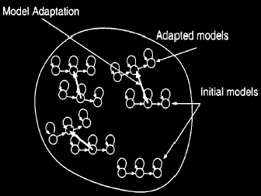
MAP: Discussion
From Re-estimation Formulae
  No adaptation data: mean NOT updated
  Large amount of data: converges to ML estimate (Baum-Welch training)
Direct (Local) Adaptation
  Advantage: good asymptotic property
  語料多時，調適效果逼近語者特定模型
  Disadvantage: unseen model not adapted
  語料少時，大多數模型無法被調整
  調適速度慢，不宜作非監督式調適
Gaussian(j, m) 對應的樣本數很少時
Gaussian(j, m) 對應的樣本數很多時
給定的參數 (定值)
Gaussian(j, m) 在語料中出現的總期望樣本數：資料量

Slide 16
Take a break, 10 minutes

Slide 17
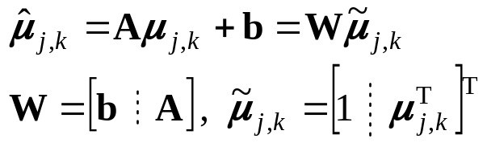
Maximum Likelihood Linear Regression (MLLR)
Transformation-based Adaptation
  All Gaussian mixture components are grouped into C regression classes
  The mixture components within the same class c: updated using the same linear transformation W_{c} 參數共享
  Adaptation data corresponding to mixture components within class c: pooled together to estimate W_{c}
Linear Regression (LR), Affine Transformation
W can be full, block-diagonal or diagonal
Class 1
Gaussian mixtures
W₂
W₁
Class 2
Model space
Adapted models

Slide 18
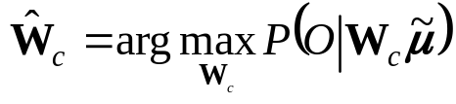
Maximum Likelihood Linear Regression (MLLR)
How to Find Linear Transformations?
  Step 1: ML criterion
  Step 2 and 3: (Skipped)
How to Determine the Complexity of Parameter Sharing?
  Concept of “Complexity”
    分群數少，則同一群內有足夠樣本數的 Gaussian 多，ROBUST but not PRECISE
    分群數多，則同一群內有足夠樣本數的 Gaussian 少，PRECISE but not ROBUST
  我們希望在 data 少的時候讓分群數少，而當 data 增加時分群數也增加：需要能夠自動調整複雜度的參數共享機制
  哪些 Gaussian 該分在同一群？Ans: 特性相似的 Gaussian
    Knowledge-based clustering: 利用語音學的知識 (phonetic knowledge)，例：子音、母音
    Data-driven clustering: 利用 Gaussian 彼此之間的距離 (distance measure) 來判定
該分幾群？哪些 Gaussian 該分在同一群？

Slide 19
Dynamic Regression Class Generating:
Regression Class Tree (RCT)
Clustering Gaussian Mixtures into a Tree-Structure
Gaussian mixtures
Global class: 所有 Gaussian 使用同一個 transformation
W₀
Model space
W₁
W₂
W₃
W₄
W₅
W₆
每一個 branch 代表將這個 node 對應的模型空間再切割 (partitioning)
出一個子空間 (subspace)
每一個 node 代表其 parent node 所對應空間的子空間

Slide 20
Dynamic Regression Class Generating:
Regression Class Tree (RCT)
Autonomous Model Complexity Control: Using RCT
Gaussian mixtures
Global class: 所有 Gaussian 使用同一個 transformation
W₀
Model space
W₁
W₂
estimated
not estimated
Gaussian mixtures with data
W₃
W₄
W₅
W₆
estimated
not estimated
設定：有足夠多樣本數的 class 才估測轉換矩陣 (設定一臨界值)
對每個 Gaussian mixture 而言，選取其所屬各階層之 node 中，包含
範圍最小、且有足夠多樣本數者，利用其轉換矩陣更新模型參數

Slide 21
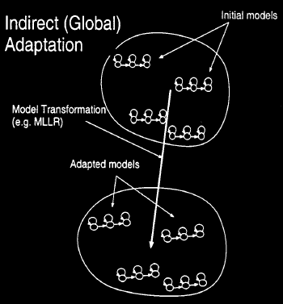
MLLR: Discussion
Indirect (Global) Adaptation
  Advantage: unseen model can be adapted
  as well due to transform parameter sharing
  調適速度快，適合用於非監督式調適
  Disadvantage: parameter sharing reduces
  degree of freedom (number of free
  parameters), thus no asymptotic property
  一旦語料量多而參數共享的複雜度沒有
  適度“鬆綁”，易造成調適效果的飽和
MLLR
MAP
Recognition
accuracy
SD models
SI models
Amount of adaptation data

Slide 22
More on MLLR
Practical Experience Using MLLR
  If the amount of data is extremely small (e.g. less than 10 seconds), estimation of full regression matrix is very difficult (from 55% to 5%)
  用full matrix 較可以精確地模擬 mean vector 中各維度參數的關係，但是參數較多，不易估測
  Using diagonal regression matrix: further reducing degree of freedom, the performance saturates even faster
  Mean vector 中各維度參數被假設為不相關 (uncorrelated)，參數數量更少，但模擬的準確性被犧牲
  Number of regression classes is critical
Other Problems
  Estimation of regression matrices should be constrained
  Transformation for individual class is estimated independently of each others: is this reasonable?
估測值應該被侷限在參數空間中的某一範圍，而非漫無根據地出現

Slide 23
Works Done by Lucent Bell Lab http://www.bell-labs.com/org/1133/Research/SpeechRecognition/sv-adaptation.html

Slide 24
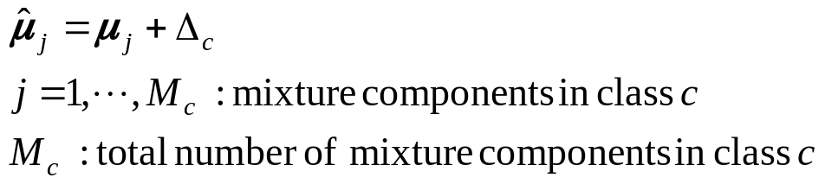
Structural MAP (SMAP) — ASRU’97
Motivation
  Trade-off between parameter sharing (transformation-based adaptation) and asymptotic property (MAP adaptation)
  目標：截長補短
Formulation
  Tree-structured Gaussian: just the same way as RCT
  Each node (class) c is associated with a bias Δ_{c}
  Step 1: Estimation criterion? Ans: Hierarchical Bayesian
  Step 2 and 3: Straightforward
Transformation-based method

Slide 25
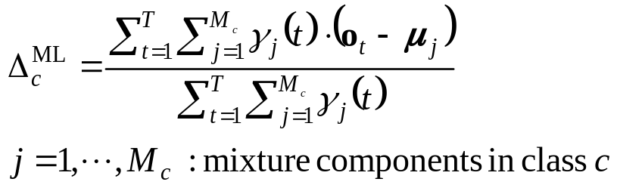
SMAP: Bias Estimation
Hierarchical Bayesian
  (1) Find ML estimate Δ_{c}^{ML} for each node with data
Gaussian mixtures
Δ₀
Δ₀^{ML}
Model space
Δ₁
Δ₁^{ML}
Δ₂
Δ₂^{ML}
Gaussian mixtures with data
0
Δ₃
Δ₄
Δ₄^{ML}
Δ₅
0
Δ₆
Δ₆^{ML}

Slide 26
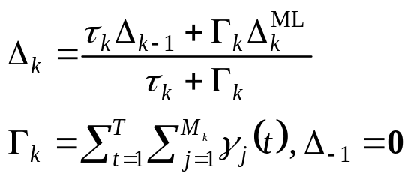
SMAP: Bias Estimation
Hierarchical Bayesian
  (2) For each branch, using the SMAP bias in the parent node
  as the prior of child node
Gaussian mixtures
Node 0
Δ₀
Δ₀^{ML}
Model space
Node 1
Δ₁
Δ₁^{ML}
Δ₂
Δ₂^{ML}
Gaussian mixtures with data
0
Δ₃
Δ₄
Δ₄^{ML}
Δ₅
0
Δ₆
Δ₆^{ML}
Node 2

Slide 27
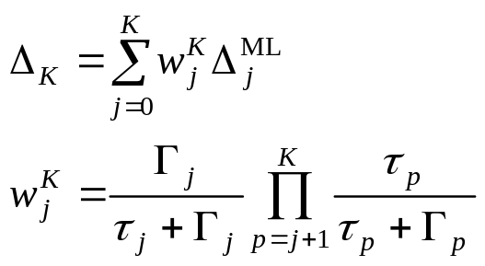
SMAP: Bias Estimation
Hierarchical Bayesian
  (3) For each Gaussian, the recursive estimation formulae can be derived
Fuzzy Clustering
  不同於 MLLR 選定一個 node，而採 weighting sum 的方式計算 bias
  語料量少時，樣本數夠多的 node 大多位於 tree 的上層，因為下方的 node 沒有足夠樣本數讓 weight 產生 exponentially decay
  語料量多時，具決定性的 node 會出現在最靠下方且具足夠樣本數的 node 上
對 Node j 而言，若其對應的樣本數 Γ_{j} 夠多
若 j 變小 (越靠近 root node)
Exponentially decayed

Slide 28
Discussion on SMAP
Better Asymptotic Property as well as Rapid Adaptation
Arguments
  Since transformation is used for mean adaptation, why not using linear regression (Aμ+b) instead of bias (μ+b)?
  The idea was furthered extended to Structural MAPLR (SMAPLR) and Extended MAPLR (EMAPLR)
SMAP
MLLR
MAP
Recognition
accuracy
SD models
SI models
Amount of adaptation data

Slide 29
Maximum A Posteriori Linear Regression (MAPLR) — EuroSpeech’99
Motivation
  As mentioned, the estimation of regression matrices in transformation-based methods should be constrained
  Instead of estimating W_{c} in ML sense, we can specify a prior distribution for W_{c} and estimating them in MAP sense
Approach
  Transformation-based adaptation
  Regression class, parameter sharing
  RCT
Probable estimation results, if unconstrained
Optimal point for W_{c}
Transformation parameter space
Region constrained by prior distribution

Slide 30
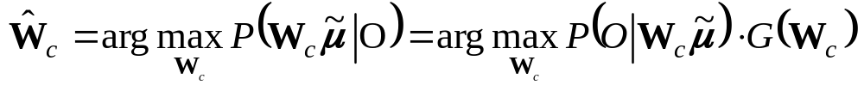
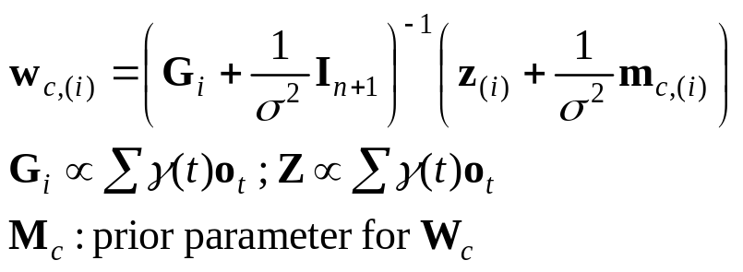
MAPLR: Transformation Estimation
Formulation
  Step 1: MAP criterion
  Prior distribution: matrix-variate normal distribution
  Step 2 and Step 3: (Skipped)
  Results:
Experimental Results
  When the amount of data is strictly limited, MAPLR performs better than MLLR
  As the amount of data increases, MAPLR converges to MLLR
  MAPLR is less sensitive to number of regression classes
Prior distribution
先前機率

Slide 31
Discussion on MAPLR
Argument
  Converging to MLLR: performance saturation still is a problem
  Prior distribution is difficult to specify
  Each transformation is still estimated independently — Shouldn't there be some correlation among these matrices?
  Since you got a regression class tree, and you used it for dynamic regression class generation, why don’t you further use it for inter-class association and prior evolution?
  People at Bell Lab did think so, so they developed SMAPLR

Slide 32
Structural MAPLR (SMAPLR) — ICSLP’2000
SMAPLR: SMAP+MAPLR
  Number of classes is still chosen according to amount of data and fixed
  EMAPLR: Find image for each Gaussian
Gaussian mixtures
Node 0
W₀
W₀^{ML}
Model space
Node 1
W₁
W₁^{ML}
W₂
W₂^{ML}
Gaussian mixtures with data
W₃
W₄
W₄^{ML}
W₅
W₆
W₆^{ML}
Node 2

Slide 33
Take a break, 10 minutes

Slide 34
Eigenvoice

Slide 35
What is Eigenspace-based Method?
Motivation
  Rapid adaptation: it is desirable to have as few free parameters to be estimated as possible — strong constraints
  Precise modeling should be maintained — meaningful constraints
  There should be a priori knowledge about acoustic mismatch due to speaker/environment variation
General Concept
  Eigenspace: considering the parameters corresponding to each speaker to reside in a “speaker space”
  Parameter analysis followed by dimensionality reduction techniques (PCA, LDA, SVD… etc.)
  (e.g.) 1000 training speakers, 90K model mean parameters,
  1000-dim speaker space, 50-dim eigenspace
  Very few free parameters, while the underlying structure of the acoustic space is preserved

Slide 36
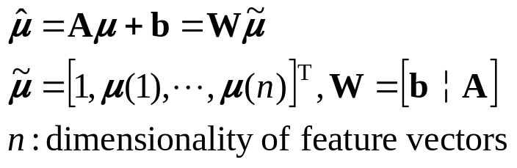
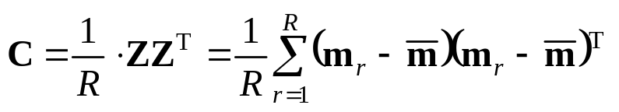
PCA-based Method (1)
Supervectors
  Concatenating the regarded parameters for each speaker r to form a huge vector m_{r}
  SD model mean parameters (μ)
  Transformation parameters (W)
  (cf.) Transformation-based adaptation:
Sample Covariance Matrix
D×R
D×D

Slide 37
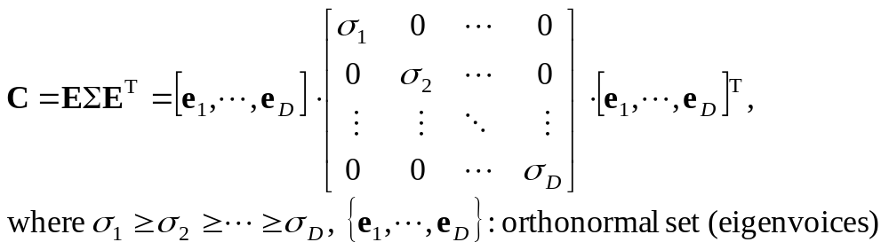
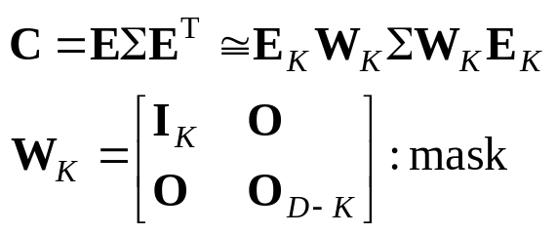
PCA-based Method (2)
Diagonalization
Eigenspace Construction
  Set the desired dimension of space to be K
D×1
R = 3
K = 2

Slide 38
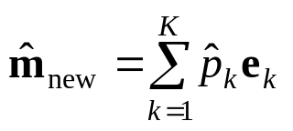
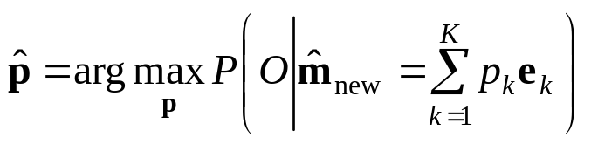
Using Eigenspace for Adaptation
Each Speaker: Confined in the Eigenspace
Re-estimating Mean Vectors for New Speaker
  New mean vectors found as a linear combination of eigenvoices
  Coordinate p: maximum likelihood eigen-decomposition (MLED)
e.g. K = 3
Training Speaker 1
Training Speaker 2
Coordinate
p = [p₁, … , p_{K}]^{T}
Test Speaker

Slide 39
Discussion on Eigenvoice Approach
Advantages
  Very few free parameters: rapid adaptation, a priori knowledge of reference speakers provides strong constraints
  Physical quantification of speaker variation
  (e.g.) Eigenvoice 1: gender of speaker
  Eigenvoice 2: amplitude
  Eigenvoice 3: formant frequency (F0)
Disadvantages
  Very few free parameters: performance tends to saturate as the amount of adaptation data increases
  High computation/memory cost: K supervectors, each composed of D elements
D >> R > K

Slide 40
Limitation of Original Eigenvoice Approach (ICSLP’98)
Original Work: Simple Task
  Alignment of mixture components in supervectors: using 1 mixture/state
  Amount of data required to be enough for SD model training: CI models
SD models from standard training: order not preserved
Mixture 1 in state 1
Mixture 2 in state 1
SD models from MAP/MLLR: order preserved (each Gaussian adapted individually)
Mixture 3 in state 1
Eigenspace-based transformation: no such problem
EuroSpeech’99: maximum likelihood eigenspace (MLES): Re-estimation of PCA-derived eigenspace, requiring less data per speaker
H. Botterweck, ICSLP’2000 : using MAP/MLLR for SD CD model training, requiring less data per speaker than BW training does
Eigenspace-based transformation: MLLR-required amount of data

Slide 41
Conclusion
References, Advanced Study

Slide 42
Conclusion
Basic concepts regarding speaker adaptation and HMM were introduced
Two common adaptation techniques, MAP and MLLR, were reviewed
Techniques developed by Bell Lab were discussed
Eigenvoice approach, which is recently very hot, was briefly introduced
Fundamental concept and mathematical background are important to SA research
Observe trajectory of technology development may gain us some sense: Pattern of research

Slide 43
References and Advanced Study
Web Sites
  HTK3 Homepage (Powerful HMM toolkit) (Link to ASR Research Sites)
  http://htk.eng.cam.ac.uk/links/asr_research.shtml
  Multimedia Communications Research Lab, Bell Lab (MAP, This Talk)
  http://www.bell-labs.com/org/1133/Research/SpeechRecognition/sv-adaptation.html
  SVR Group, Engineering Department, Cambridge University (MLLR)
  http://svr-www.eng.cam.ac.uk/svr.html
Overview
  P. C. Woodland, “Speaker adaptation: Techniques and challenges,” Workshop ASRU, 1999
  C.-H. Lee and Q. Huo, “On adaptive decision rules and decision parameter adaptation for automatic speech recognition,” Proc. of the IEEE, vol. 88, no. 8, Aug. 2000

Slide 44
References and Advanced Study
Newer
  O. Siohan, C. Chesta, and C.-H. Lee, “Joint maximum a posteriori adaptation of transformation and HMM parameters,” IEEE Trans. SAP, vol. 9, no. 4, May 2001
  R. Kuhn, J.-C. Junqua, P. Nguyen, and N. Niedzielski, “Rapid speaker adaptation in eigenvoice space,” IEEE Trans. SAP, vol. 8, no. 6, Nov. 2000
Conferences
  Internation Conf. Acoustic, Speech, and Signal Processing (ICASSP) 2001: Sessions SPEECH-P3, SPEECH-L5
Contact K.-T. Chen: kenneth@iis.sinica.edu.tw

Slide 45
Thanks for Your Attention and Tolerance!

